Slide 1



Slide 2
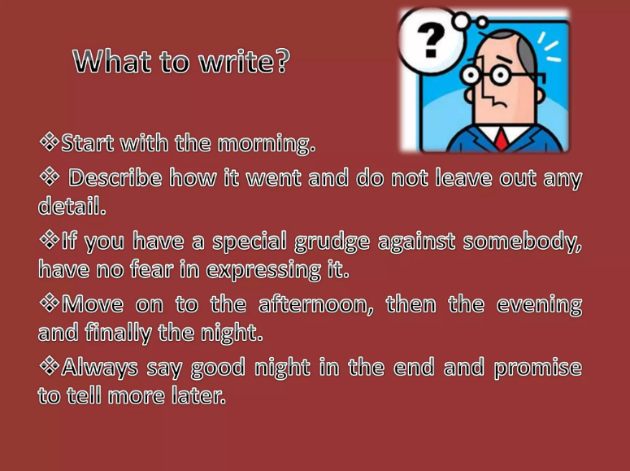

Slide 3
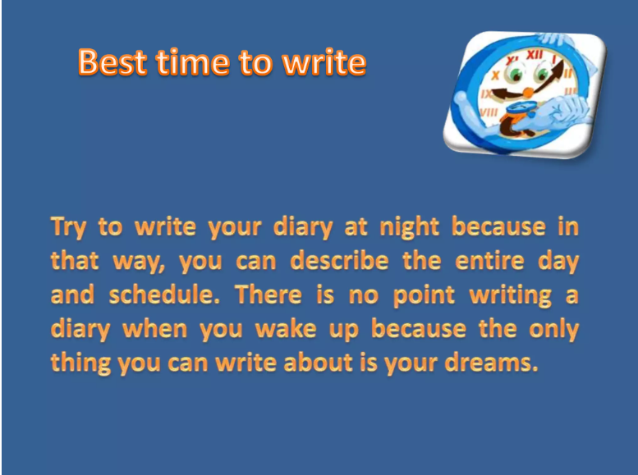

Slide 4
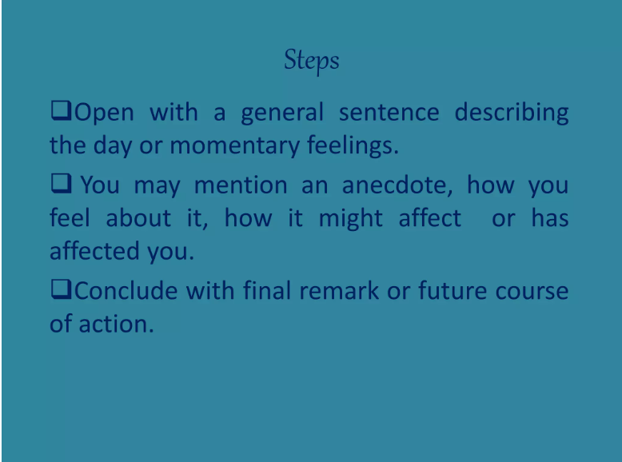

Slide 5


Slide 6
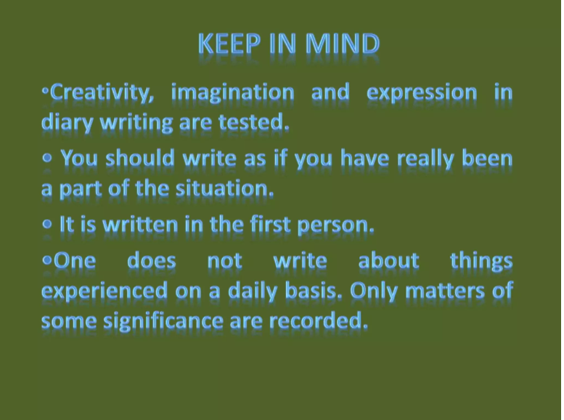

Slide 7
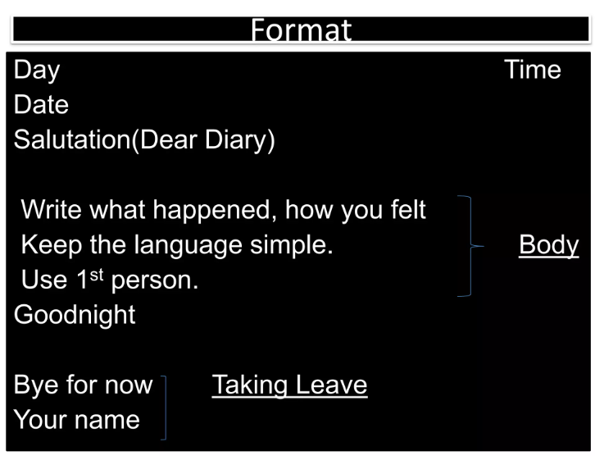

Slide 8


Slide 13
Nithya Prakash /FACULTY/English/SNSACD

Slide 14
Nithya Prakash /FACULTY/English/SNSACD

